Slide 1
ARP, RARP,ICMP
Lecture-1

Slide 2
OBJECTIVES:
To make a distinction between logical address (IP address) and physical address (MAC address).
To describe how the mapping of a logical address to a physical address can be static or dynamic.
To show how the address resolution protocol (ARP) is used to dynamically map a logical address to a physical address.
To show that the proxy ARP can be used to create a subnetting effect.
To discuss ATMARP, which maps the IP addresses when the underlying network is an ATM WAN.
To show that an ARP software package can be made of five components.
To show the pseudocode for each module used in the ARP software package.

Slide 3
Address Mapping
The delivery of a packet to a host or a router requires two levels of addressing: logical and physical. We need to be able to map a logical address to its corresponding physical address and vice versa. These can be done using either static or dynamic mapping.

Slide 4
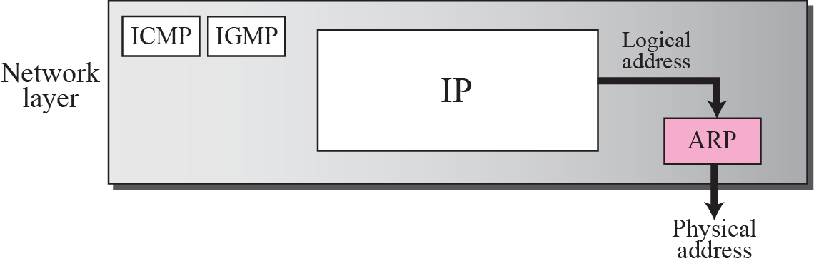
Position of ARP in TCP/IP protocol suite

Slide 5
ARP operation

Slide 6
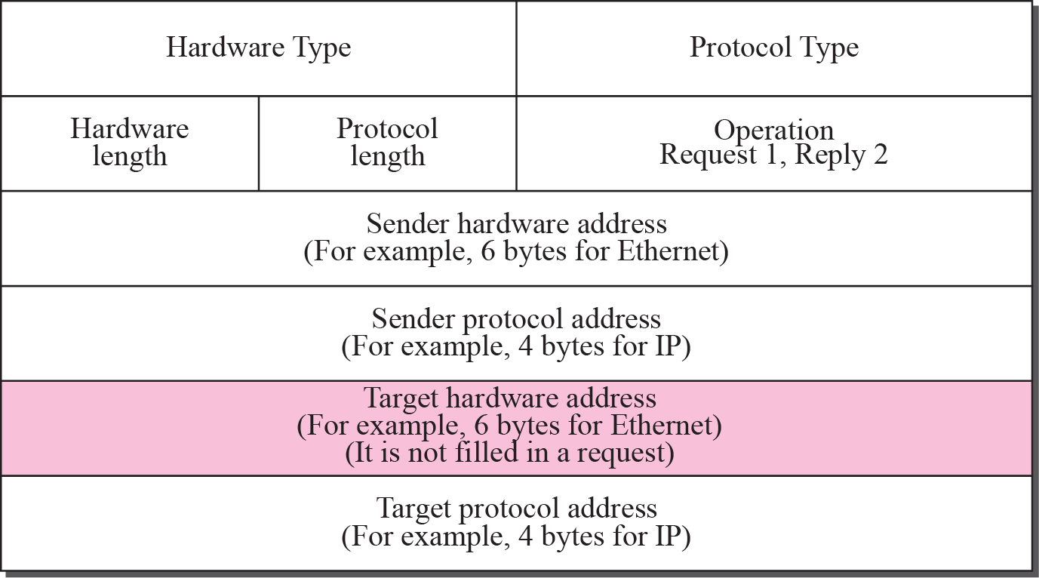
ARP packet

Slide 7
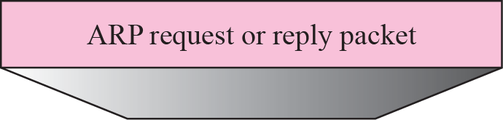
Encapsulation of ARP packet

Slide 8
An ARP request is broadcast; an ARP reply is unicast.

Slide 9
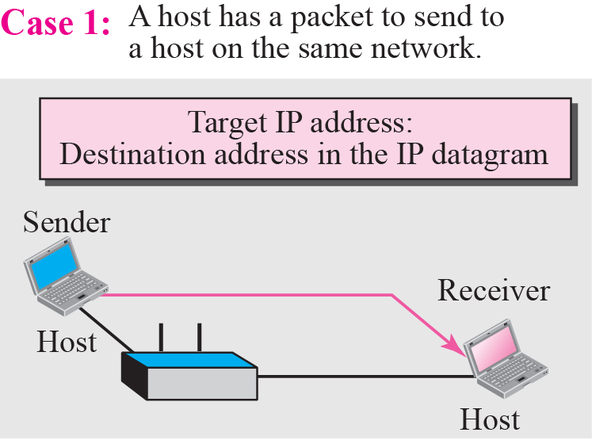
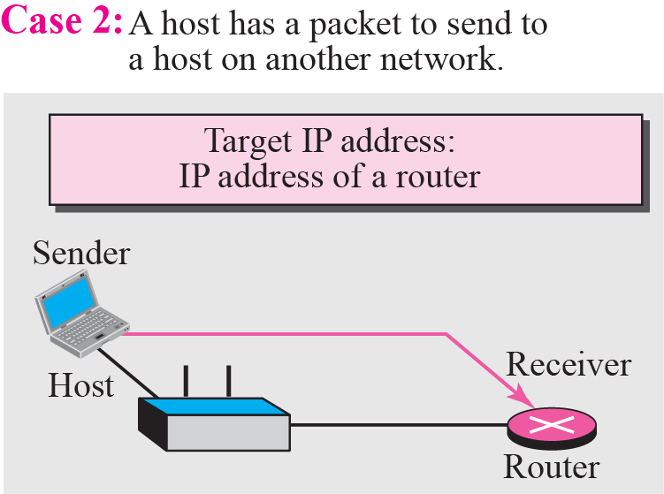
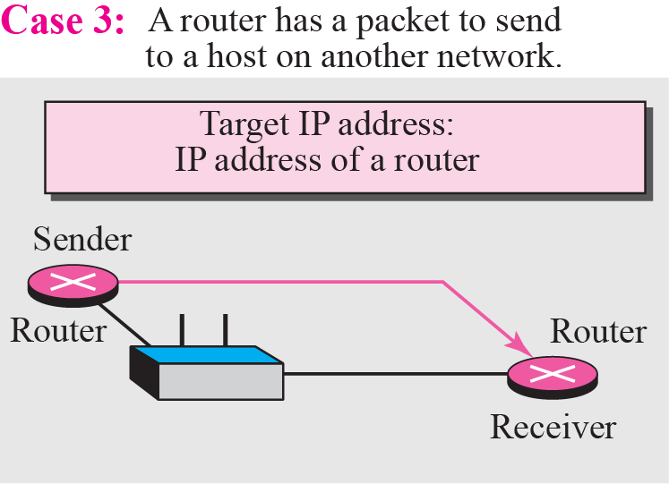
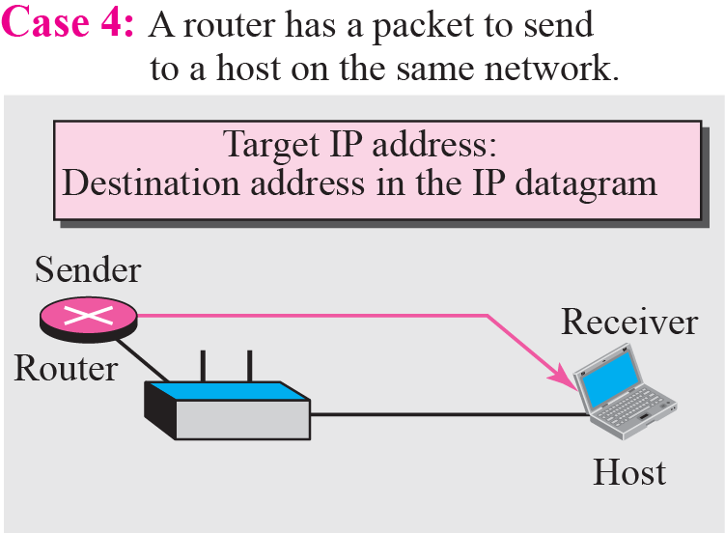
Four cases using ARP

Slide 10
ATM-ARP
When IP packet are moving through an ATMWAN, a mechanism protocol is needed to find (map) the physical address of the exiting-point router in the ATM WAN given the IP address of the router. This is the same task performed by ARP on a LAN.

Slide 11
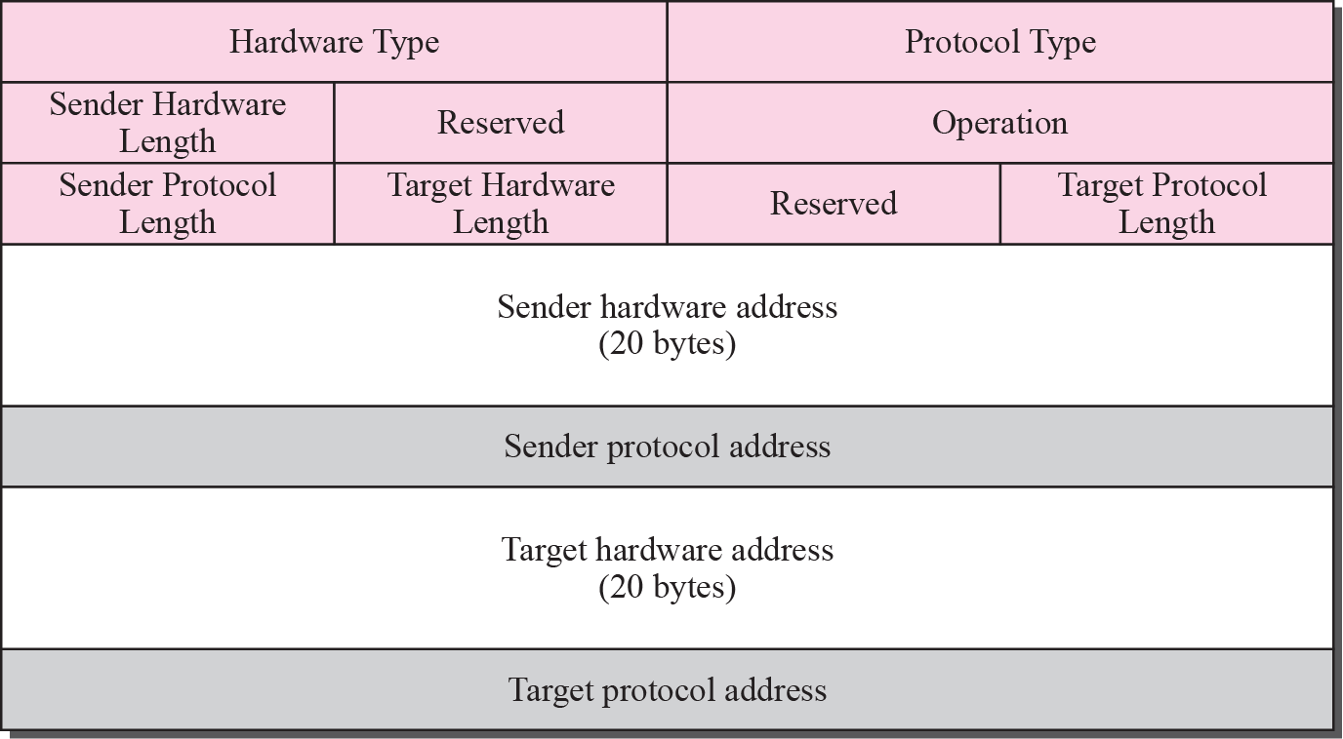
ATM-ARP PACKET

Slide 13
The inverse request and inverse reply messages can bind the physical address to an IP address in a PVC situation.

Slide 14
Fig. Binding with PVC

Slide 15
Figure : Binding with ATMARP
Finding physical
address

Slide 16
The request and reply message can be used to bind a physical address to an
IP address in an SVC situation.
The inverse request and inverse reply can also be used to build the server’s mapping table.

Slide 17
Fig: Building a table

Slide 18
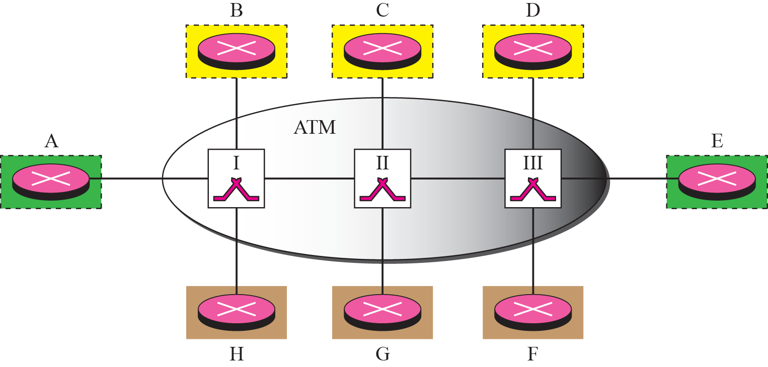
Fig.: LIS

Slide 19
LIS allows an ATM network to be divided into several logical subnets.
To use ATMARP, we need a separate server for each subnet.

Slide 20
ARP Package Components
Cache Table
Queues
Output Module
Input Module
Cache-Control Module

Slide 21
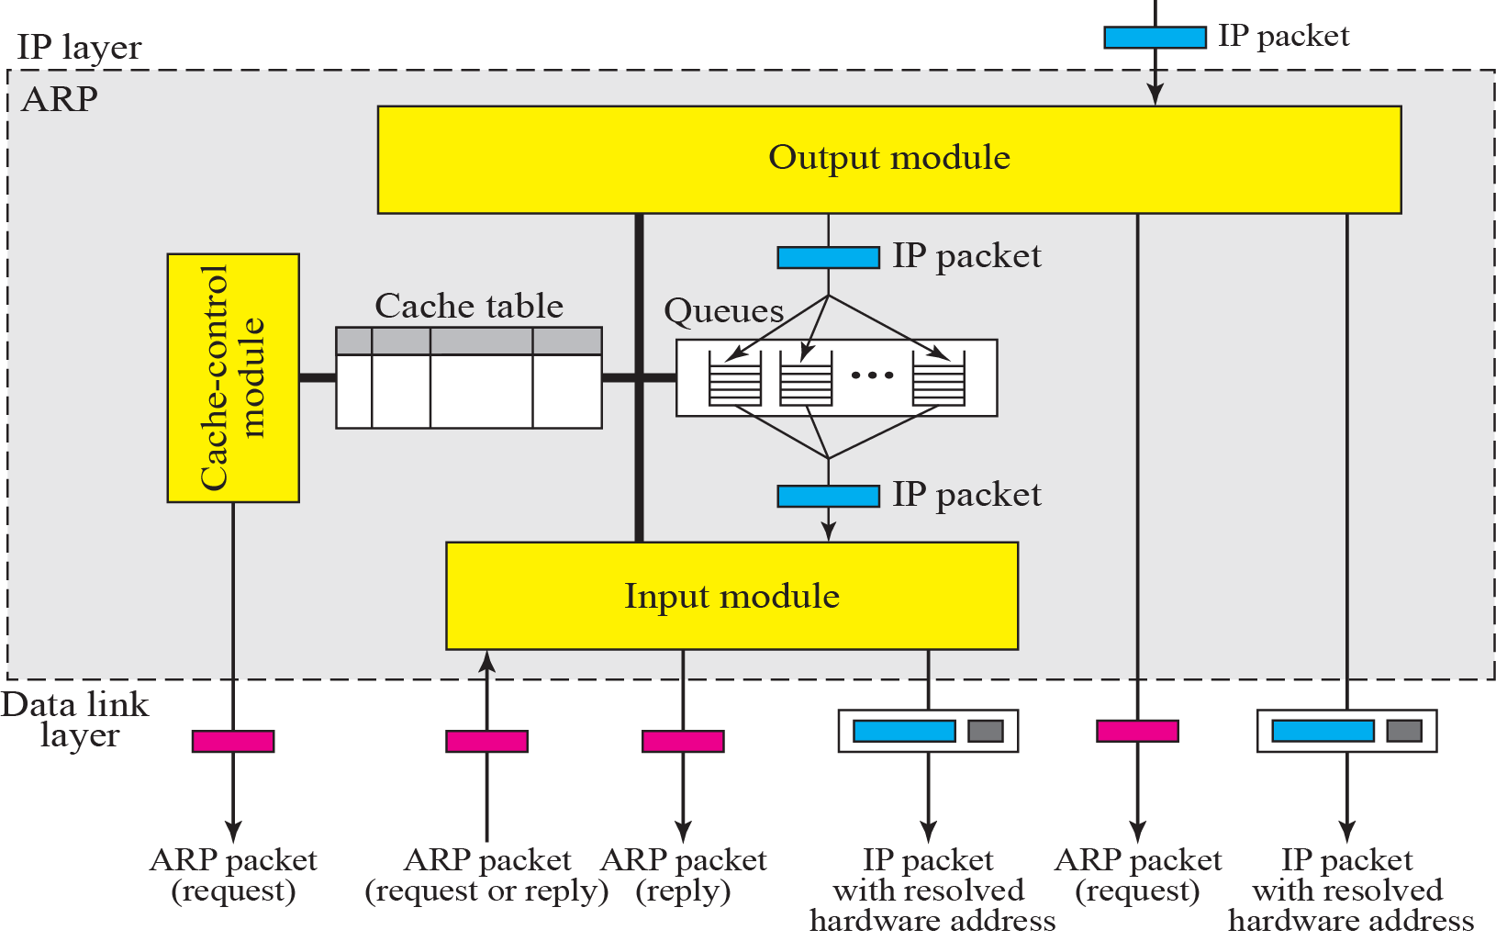
ARP components

Slide 22
The Cache Table
If ARP just resolved an IP address, chances are a few moments later someone is going to ask to resolve the same IP address
When ARP returns a MAC address, it is placed in a cache. When the next request comes in for the same IP address, look first in the cache

Slide 23
The Cache Table Contents
State: FREE, PENDING, RESOLVED
Hardware type: same as ARP field
Protocol type: same as ARP field
Hardware length: same as ARP field
Protocol length: same as ARP field
Interface number: port number (m0,m1, m2)

Slide 24
The Cache Table Contents
Queue number: which queue the ARP request is sitting in
Attempts: how many times have you tried to resolve this address?
Time-out: how long until this address is tossed out (need the room in cache)
Hardware address: destination hardware address
Protocol address: destination IP address

Slide 25
How Does the Cache Work?
The output module waits for an IP packet with a request
Checks the cache for an existing entry
If entry found and state RESOLVED, we already have this MAC address
If entry found and state PENDING, packet waits until dest hard addr found

Slide 26
How Does the Cache Work?
If no entry found, output module places this request in queue, and a new entry is placed in cache with state PENDING and ATTEMPTS set to 1. An ARP request is then broadcast

Slide 27
How Does the Cache Work?
The input module waits until an ARP request or reply arrives
Module checks the cache for this entry
If entry is found and state is PENDING, module updates entry’s target hardware address, changes state to RESOLVED, and sets the TIME-OUT value

Slide 28
How Does the Cache Work?
If entry is found and state RESOLVED, module still updates the entry (target hardware address could have changed) and the TIME-OUT value reset
If entry not found, module creates a new entry. State is set to RESOLVED and TIME-OUT is set

Slide 29
How Does the Cache Work?
Now the module checks to see if arrived ARP packet is a Request. If it is, the module immediately creates an ARP Reply message and sends it back to sender.

Slide 30
How Does the Cache Work?
The cache-control module periodically checks each cache entry
If entry’s state is FREE, skips it
If entry’s state is PENDING, Attempts field is incremented by 1. This value greater than max? Toss this entry (and mark entry as FREE). Less than max? Send another ARP request

Slide 31
How Does the Cache Work?
If state of entry is RESOLVED, module decrements value of Time-out field accordingly
If Time-out field < 0, then remove entry and set state to FREE

Slide 32
RARP
RARP finds the logical address for a machine that only knows its physical address.
This if often encountered on thin-client workstations. No disk, so when
machine is booted, it needs to know its IP address (don’t want to burn
the IP address into the ROM).
RARP requests are broadcast, RARP replies are unicast.
If a thin-client workstation needs to know its IP address, it probably
also needs to know its subnet mask, router address, DNS address, etc. So we need something more than RARP. BOOTP, and now DHCP have replaced RARP.

Slide 33
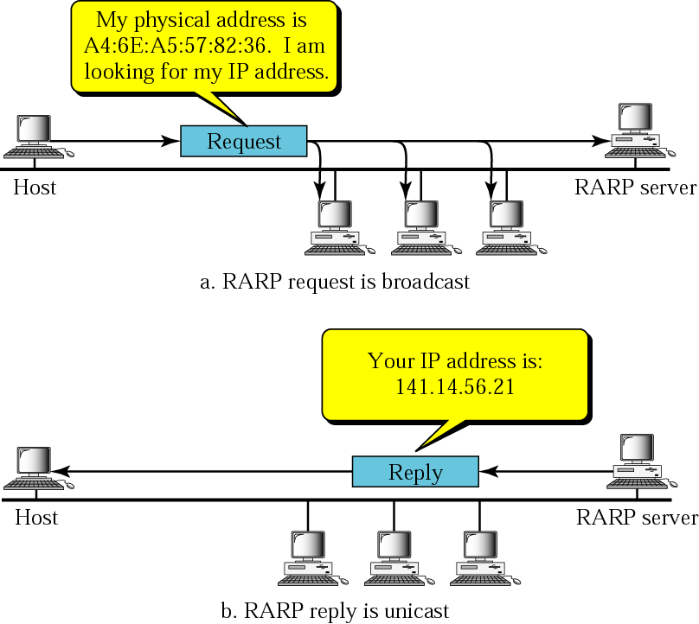
RARP Operation

Slide 34
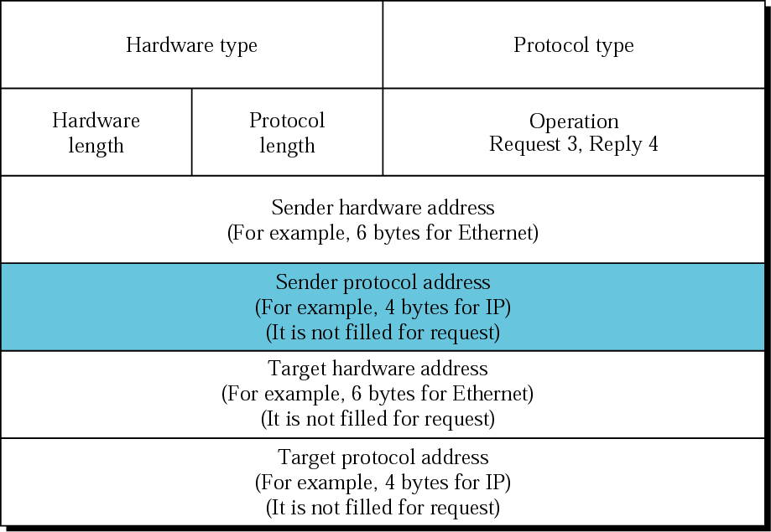
RARP packet

Slide 35
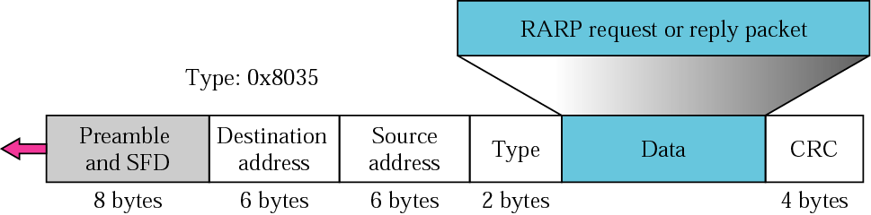
Encapsulation of RARP packet

Slide 36
ICMP
The IP protocol has no error-reporting or error-correcting mechanism. The IP protocol also lacks a mechanism for host and management queries. The Internet Control Message Protocol (ICMP) has been designed to compensate for the above two deficiencies. It is a companion to the IP protocol.

Slide 37
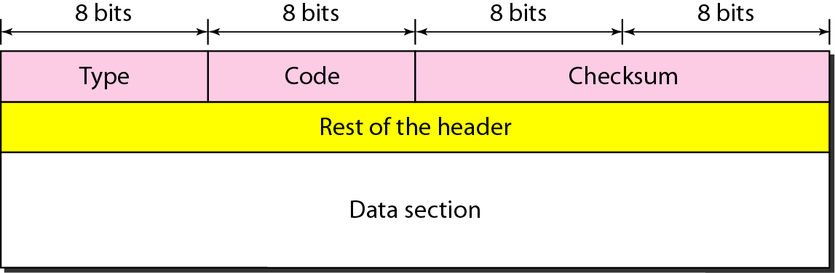
General format of ICMP messages

Slide 38
ICMP always reports error messages to the original source.

Slide 39
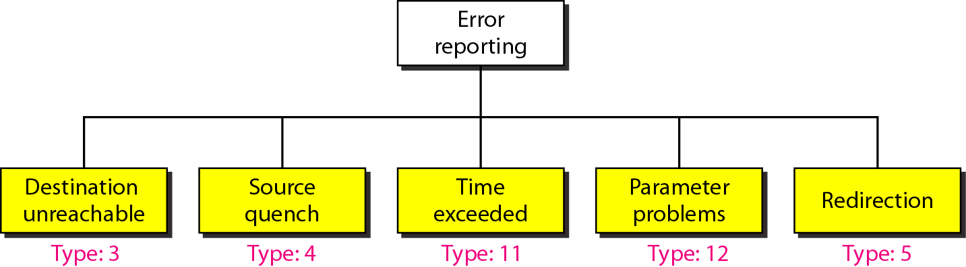
Error-reporting messages

Slide 40
Important points about ICMP error messages:
No ICMP error message will be generated in response to a datagram carrying an ICMP error message.
No ICMP error message will be generated for a fragmented datagram that is not the first fragment.
No ICMP error message will be generated for a datagram having a multicast address.
No ICMP error message will be generated for a datagram having a special address such as 127.0.0.0 or 0.0.0.0.

Slide 41
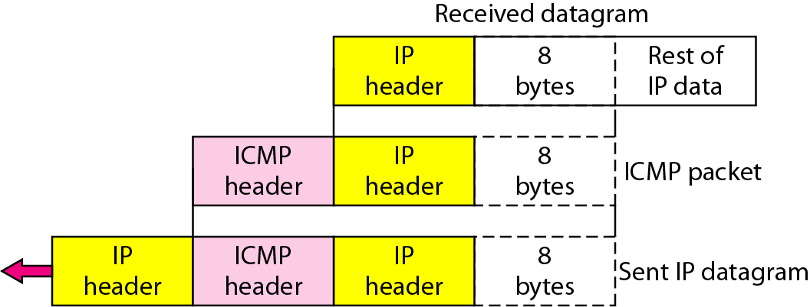
Contents of data field for the error messages

Slide 42
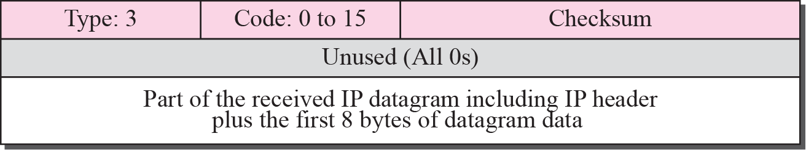
Destination-unreachable format

Slide 43
Destination-unreachable messages with codes 2 or 3 can be created only by the
destination host. Other destination-unreachable messages can be created only by routers.
Destination-unreachable messages with codes 2 or 3 can be created only by the
destination host. Other destination-unreachable messages can be created only by routers.

Slide 44
A router cannot detect all problems that prevent the delivery of a packet.

Slide 45
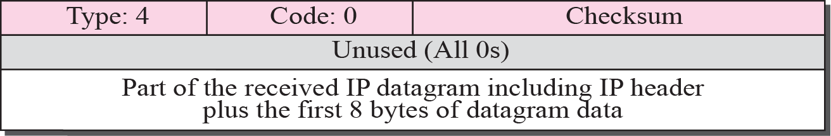
Source-quench format

Slide 46
A source-quench message informs the source that a datagram has been discarded due to congestion in a router or the destination host.
The source must slow down the sending of datagrams until the congestion is relieved.

Slide 47
Whenever a router decrements a datagram with a time-to-live value to zero, it discards the datagram and
sends a time-exceeded message to the original source.

Slide 48
When the final destination does not receive all of the fragments in a set time, it discards the received fragments and sends a time-exceeded message to the original source.

Slide 49
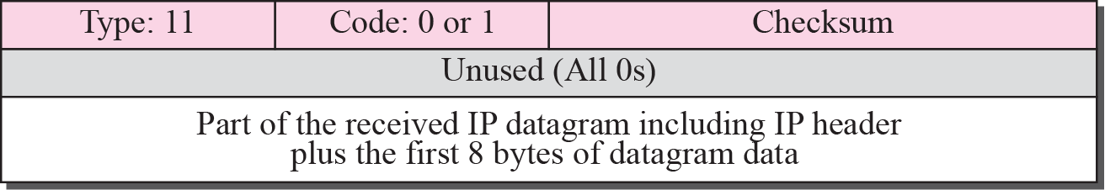
Time-exceeded message format

Slide 50
In a time-exceeded message, code 0 is used only by routers to show that the value of the time-to-live field is zero. Code 1 is used only by the destination host to show that not all of the fragments have arrived within a set time.

Slide 51
A parameter-problem message can be created by a router or the destination host.

Slide 52
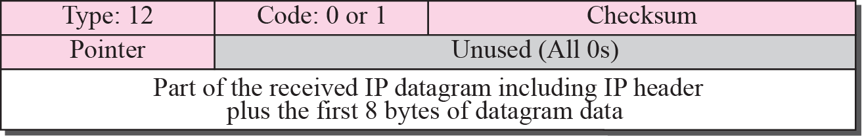
Parameter-problem message format

Slide 53
A host usually starts with a small routing table that is gradually augmented and updated.
One of the tools to accomplish this is the redirection message.

Slide 54
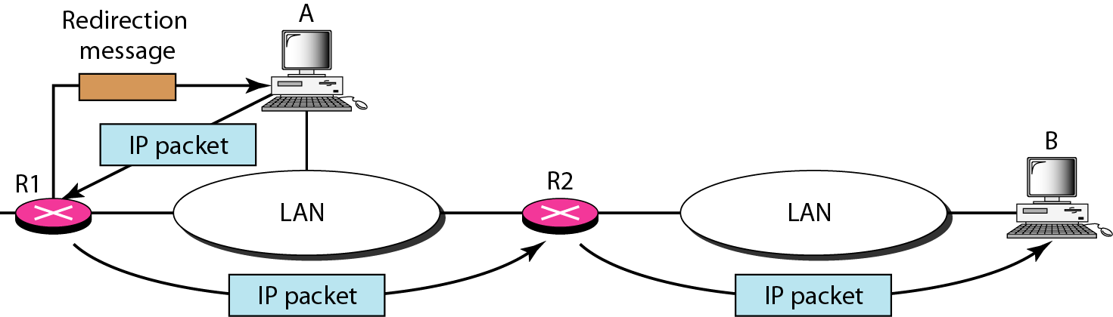
Redirection concept

Slide 55
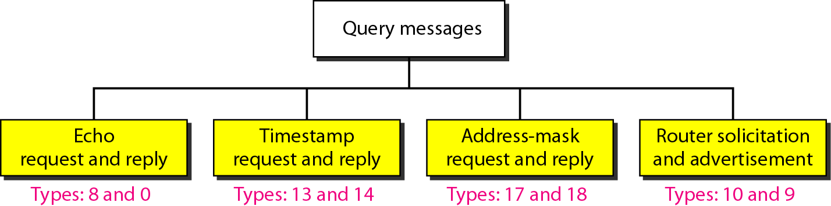
Query messages

Slide 56
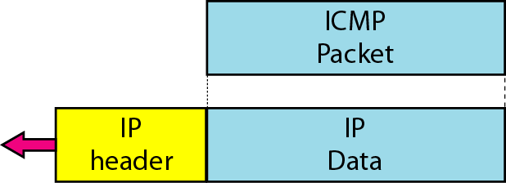
Encapsulation of ICMP query messages

Slide 57
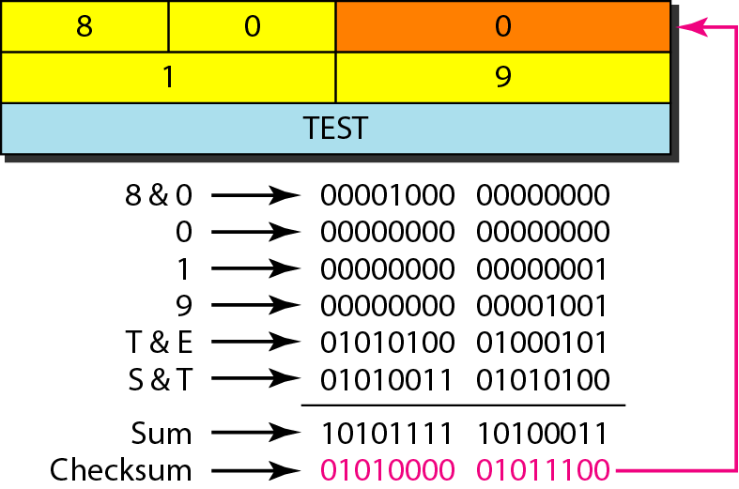
Example of checksum calculation

